Slide 1
Fundamental Data Structures
Lists

Slide 2
Lists - Introduction
Some applications require processing data in a strict chronological order.
Example:
Processing objects in the order that they arrived
OR
Processing objects in the reverse of the order
that they arrived
For all these situations, a simple list structure is appropriate.

Slide 3
Lists – Definition (1/3)
A list is a finite, ordered sequence of data items called elements.
Important concept: List elements have a position.
[1st element in the list, 2nd element, and so on.]
Notation: <a₀, a₁, …, a_{n-1}>
[“Ordered”: the positions are ordered, NOT the values.]
Each list element has a data type (all same data type, but not necessarily).
Notes:
Students should already be familiar with lists.
Chapter objective: Use algorithm analysis in a familiar context to compare implementations.

Slide 4
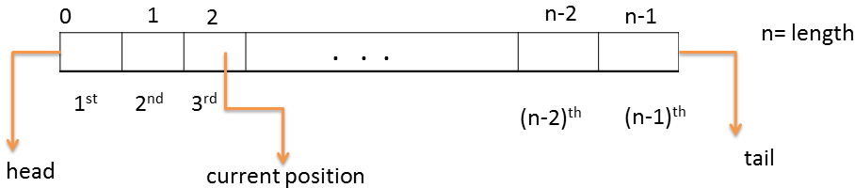
Lists – Definition (2/3)
The empty list contains no elements.
The length of the list is the number of elements currently stored.
The beginning of the list is called the head, the end of the list is called the tail.

Slide 5
Lists – Definition (3/3)
Sorted lists have their elements positioned in ascending order of value, while unsorted lists have no necessary relationship between element values and positions.
What operations should we implement?
[Design the basic operations first]

Slide 6
List Implementation Concepts
Our list implementation will support the concept of a current position.
[Basic operations:]
add, find and delete element anywhere, next, previous, clear (reinitialize), test for empty.

Slide 7
List ADT
[We will use the C++ notation of an abstract class to formally define the list ADT.]
[An abstract class does not specify how operations are implemented, and can’t be instantiated.]
class List {
public:
virtual void clear() = 0;//Remove all objects in the list.
virtual bool insert(datatype item) =0;//Insert at curr pos
virtual bool append(datatype item)= 0; //Insert at the tail
virtual bool remove() = 0; //Remove & return curr pos
virtual void setStart() = 0; //set to first pos
virtual void setEnd() = 0; //set to last pos
virtual void prev() = 0; // Move to previous pos
virtual void next() = 0; // Move to next pos
Notes:
This is an example ADT that our list implementations must match.

Slide 8
List ADT (cont)
virtual int length() = 0; // Return curr length
virtual bool setPos(int pos) = 0; // Set curr position
virtual bool getValue() = 0; // Return curr value
virtual void print() = 0; // Print all elements
};
[This is an example ADT that our list implementations must match.]
Notes:
This is an example ADT that our list implementations must match.

Slide 9
List ADT Examples
List: (12, 32, 15)
MyLst.insert(element);
[The above is an example use of the insert function. “element” is a data item of the list element data type.]
Assume MyLst has 32 as current element:
MyList.insert(99);
Result: (12 ,99, 32, 15)
[Put 99 before current element, yielding (12, 99, 32, 15).]
Iterate through the whole list:
for(MyList.setStart();MyList.length()>0;MyList.next()){
it = MyList.getValue();
doSomething(it);}

Slide 10
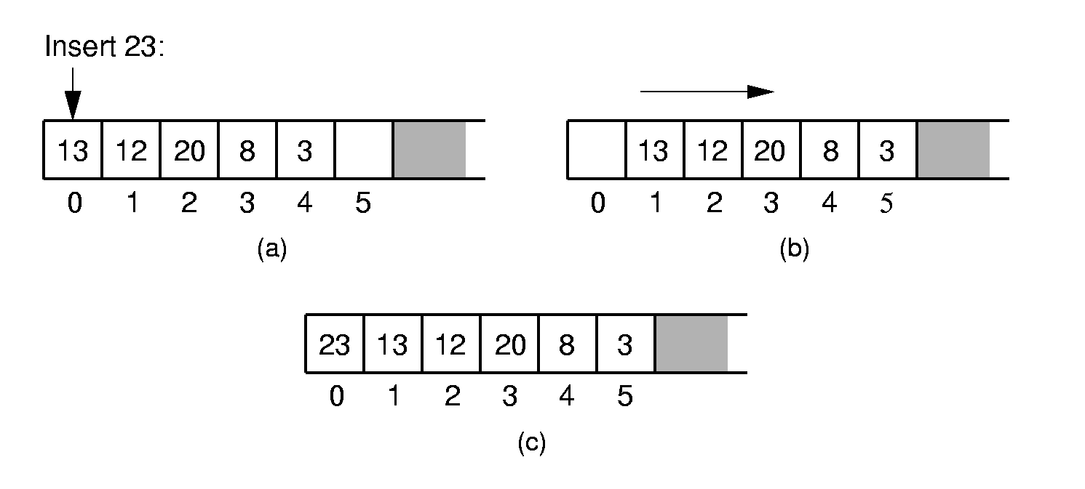
Array-Based List Implementation
[There are two standard approaches to implementing lists, the array-based list and the linked list.]
Array-Based List Insert:
[Push items up/down. Cost: Θ(n).]
Inserting an element at the head of an array-based list requires shifting all existing elements in the array by one position toward the tail.

Slide 11
Array-Based List Class (1)
//Array-based list
class AList : public List{
private:
int maxSize; // Maximum size of list
int listSize; // Actual elem count
int curr; // Position of curr
datatype listArray; // Array holding list
public:
AList(int size=DefaultListSize) { // Constructor
maxSize = size;
listSize = curr = 0;
listArray = new datatype[maxSize];
}
~AList() { delete [] listArray; } // Destructor

Slide 12
Array-Based List Class (2)
void clear() { //Reinitialize the list
delete [] listArray;
listSize = curr = 0;
listArray = new datatype[maxSize];
}
void setStart() { curr = 0; }
void setEnd() { curr = listSize; }
void prev() { if (curr != 0) curr--; }
void next() { if (curr <= listSize)
curr++; }
int length() { return listSize; }
bool setPos(int pos) {
if ((pos >= 0) && (pos <= listSize))
curr = pos;
return (pos >= 0) && (pos <= listSize);
}

Slide 13
Array-Based List Class (3)
//get current value
bool getValue(){
if (listSize == 0)return false;
else{
it = listArray[curr];
return true;}
}
// Insert at corrent position
bool insert(datatype item) {
if (listSize == maxSize) return false;
for(int i=listSize; i>curr; i--)
// Shift Elems up to make room
listArray[i] = listArray[i-1];
listArray[curr] = item;
listSize++; // Increment list size
return true;
}

Slide 14
Array-Based List Class (4)
// Append element to end of the list
bool append(datatype item) {
if (listSize == maxSize) return false;
listArray[listSize++] = item;
return true;
}
// Remove and return curr element
bool remove() {
if (length() == 0) return false;
it = listArray[curr]; // Copy element
for(int i=curr; i<listSize-1; i++)
// Shift them down
listArray[i] = listArray[i+1];
listSize--; // Decrement size
return true;
}
…………
}

